Slide 1
PSSA 2024
3rd grade

Slide 2
Agenda/Topics to Be Covered
What is PSSA?
On- line testing
What does PSSA look like in 3rd grade?
Sample question for ELA and Math
How can you help to prepare your child?

Slide 3
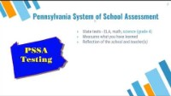
What is PSSA?

Slide 4
On-line testing
Students will use their chrome books--must come to school fully charged
Opportunities to practice with on-line tools will be provided
Students will be closely monitored

Slide 5
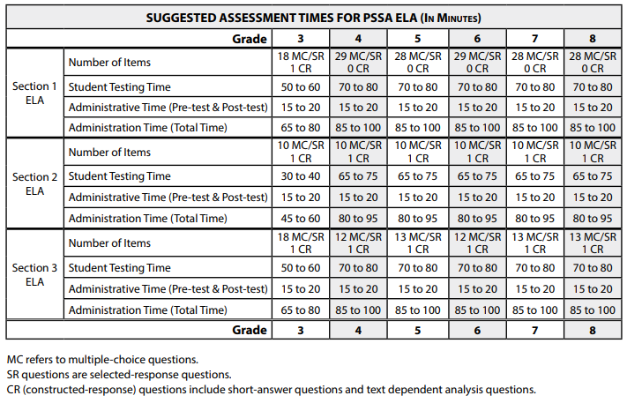











What does PSSA look like in 3rd grade?

Slide 6

Days for ELA testing
Wednesday April 24th, 2024
Thursday April 25th, 2024
Friday April 26th, 2024

Slide 7
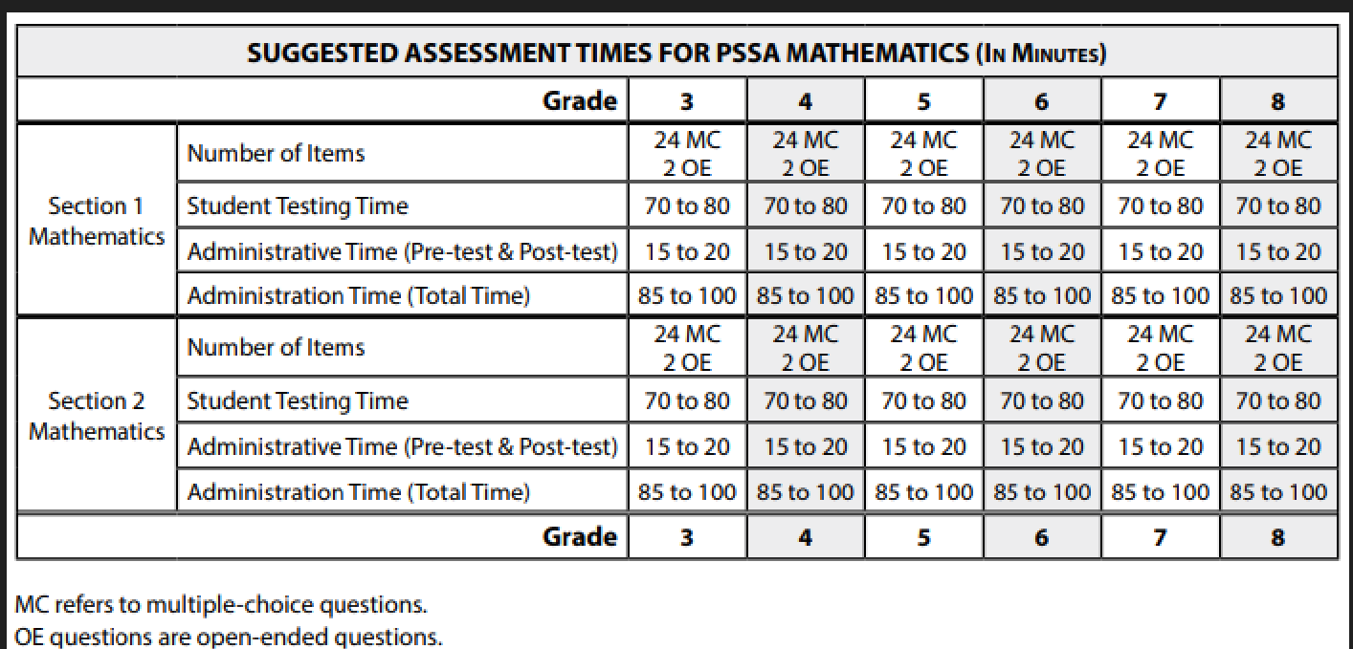
Math PSSA

Slide 8

Math testing Days
Monday April 29th, 2024
Tuesday April 30th , 2024

Slide 9
Sample questions
ELA PSSA sample questions
Math PSSA sample questions

Slide 10

How to prepare your child
Make sure they have a good night’s rest
Have them come to school with a fully charged device
Make sure that they eat a good breakfast
Arrive to school on time
Encourage them to do their best
Prevention Pulse Newsletter #32 (1).pdf
2024 Parent Info for PSSA.docx.pdf

Slide 11

Please reach out to your child’s teacher if you have any questions.

